Slide 1
DESIGN METHODOLOGY AND STRATEGIES

Slide 2
X’TICS
Duplicate functional units to allow multiple execution
Processing is done in-order
Dependences between a potential issue pair, that may result into a hazard are resolved by allowing only the first instruction in program order to execute.
Hazards between succeeding and preceding stages are resolved using pipeline hazard resolution techniques

Slide 3
TOP LEVEL MODULE
Instruction scheduler is between instruction memory and scalar processor to ensure no 2 instructions whose simultaneous execution may result into a hazard are executed together.
Instruction scheduler generates a select signal that allows the pc be increased by 4 or 8

Slide 4
Instruction Scheduler (In depth)
Determines if an execution pair is valid for execution
Determination is done based on the existence of a data or control hazard
Data and output dependences can be determined by examining the pair and the values in the fields of their architecture.
The scheduler finally generates a mux select signal to select between the values 4 and 8 used to determine PC’s next value

Slide 5
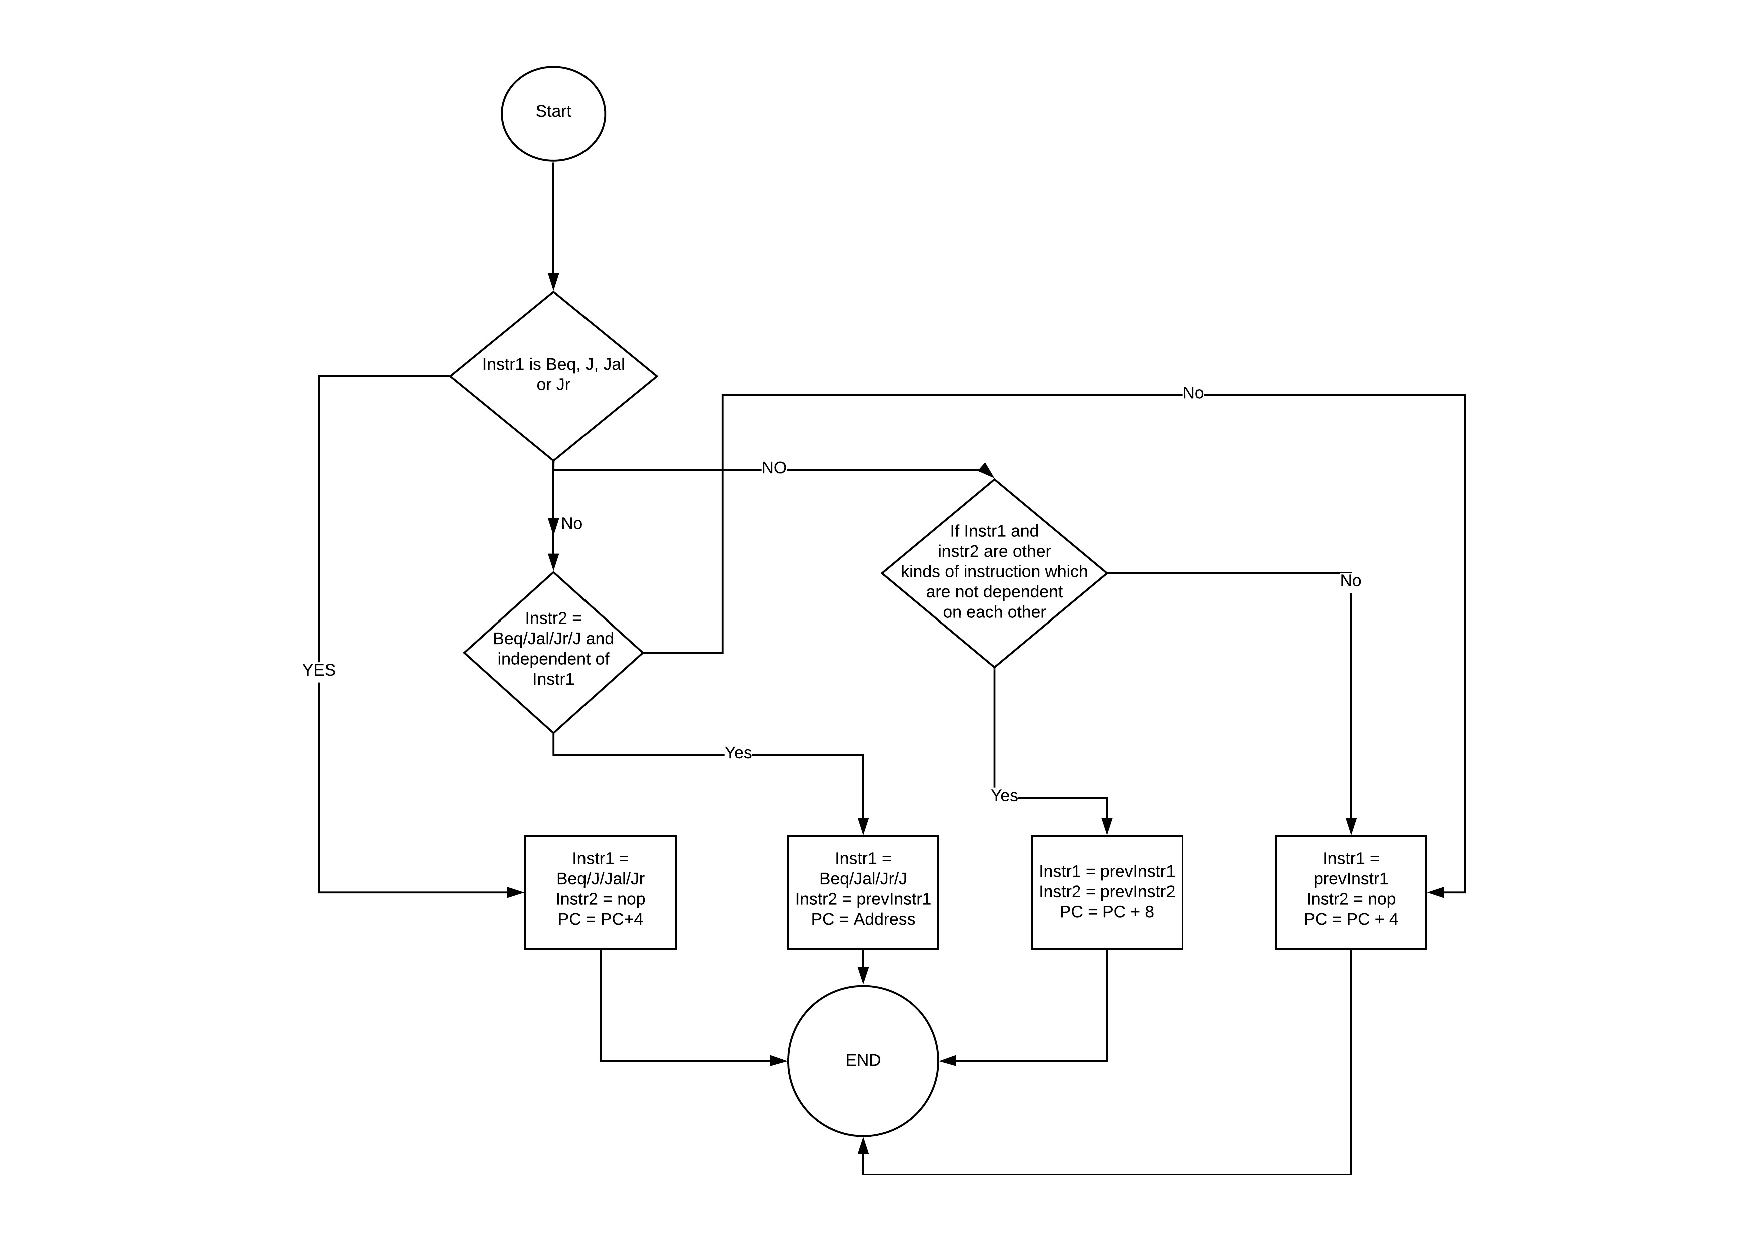
SIMPLIFIED FLOWCHART SHOWING OPERATION OF INSTRUCTION SCHEDULER

Slide 6
Testing the Instruction Scheduler

Slide 7
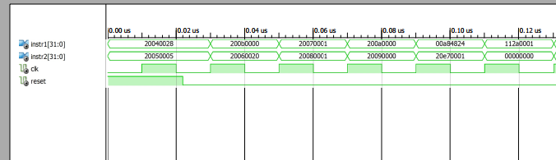
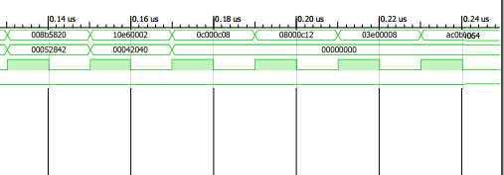
SIMULATION

Slide 8
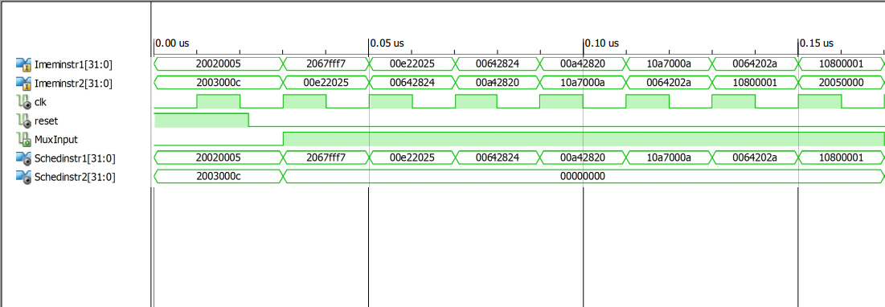
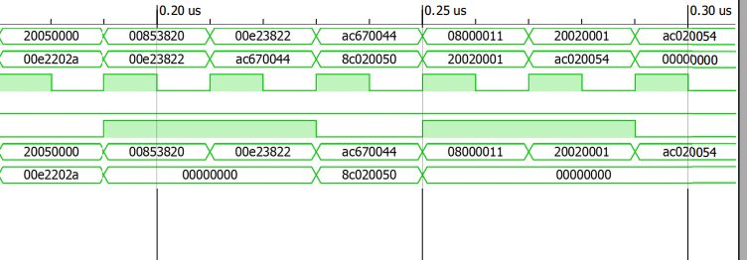
SIMULATION

Slide 9
DATAPATH X’TICS
Has enough functional units to support the execution of 2 instructions at a time; IPC = 2
Datapath is designed to accommodate conditional and unconditional Branches or Jumps on the first path only
Accommodation is made possible by the operation of the instruction scheduler.
Inter stage and inter path forwarding
Inter stage data and control hazards are resolved by s

Slide 10
FULL PATH

Slide 11
PATH 1

Slide 12
WAY2

Slide 13
PUTTING EVERYTHING TOGETHER AND SIMULATION

Slide 14
NEXT STEPS : Design of a Dynamically Scheduled OOO processor based on the Tomasulo’s algorithm with speculation

Slide 15
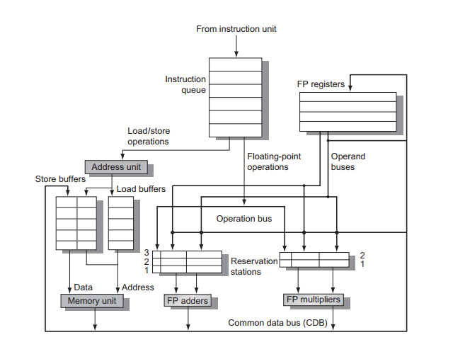
DYNAMIC SCHEDULING & TOMASULO’S ALGORITHM

